Slide 1
Case Study Utility sector Remediation Waste
Martin E. Sánchez
NJDEP

Slide 2
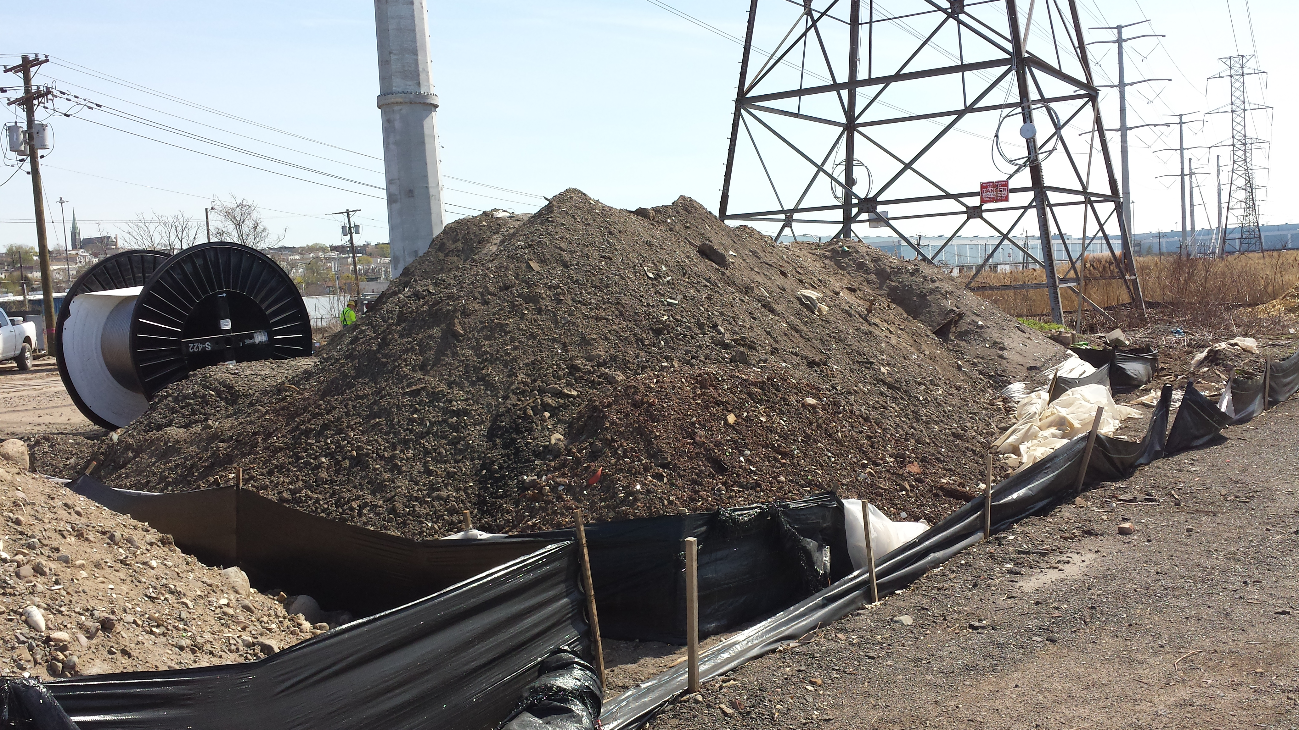
Background
As a result of upgrading substation, utility company generated waste excavated soils.
The excavated soils were accumulated in piles and then sampled for determination.
The soil piles were found to be above regulatory levels (TCLP) for lead.
The substation generated Large Quantity Generator amounts of D008 hazardous (>2,200 lbs./month).
As per RCRA, generators of hazardous can accumulate hazardous waste for less than 90 days without applying for Part A/Part B RCRA permit. Generators can only accumulate in containers, tanks, containment buildings and drip pads.

Slide 3
LSRP / Utility Co. Response
Excavated soil was handled in accordance with the linear construction guidance document which allows soil to be stockpiled and contained while being tested for disposal.
These sites are undergoing remediation and RCRA requirements are not applicable.
Linear Construction Technical Guidance
http://www.nj.gov/dep/srp/guidance/srra/lc_guidance.pdf

Slide 4
Inspection Findings
Excavated soils from the substation are not subject to the Linear Construction Technical Guidance but are a traditional LSRP case which would link to the linear construction project.
Contamination found must be reported to the DEP Hotline.
Since excavated soils were found to be above regulatory levels (TCLP) for lead, the substation is a hazardous waste generator and all applicable RCRA requirements apply.
Notice of Violation was issued

Slide 5
Notice of Violation Issued
Failed to determine the waste excavated soils were D008 hazardous waste prior accumulation in waste piles.
Failed to place Waste lead contaminated soil (D008 hazardous waste) in containers instead of waste piles.
Constructed and accumulated Waste lead contaminated soil (D008 hazardous waste) in waste piles without obtaining or submitting a Part A or Part B permit application.
Settlement was reached with Company after the violations corrected.

